Slide 1
Superstore Sales Dashboard

Slide 2
Total Sales | 2,326,534
Total Profit | 292,297
Total Orders | 10,194

Slide 3
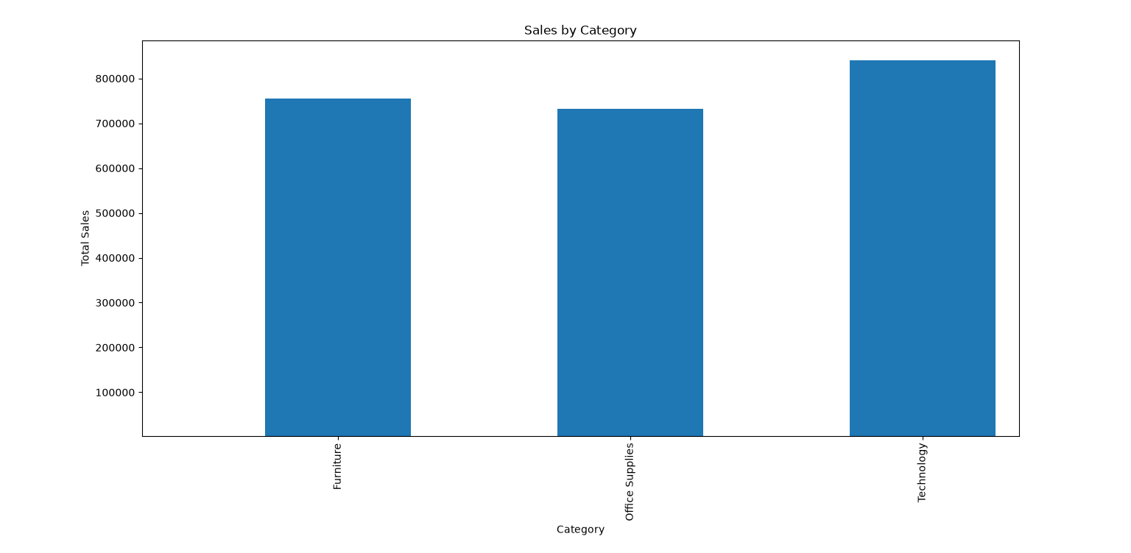

Slide 4
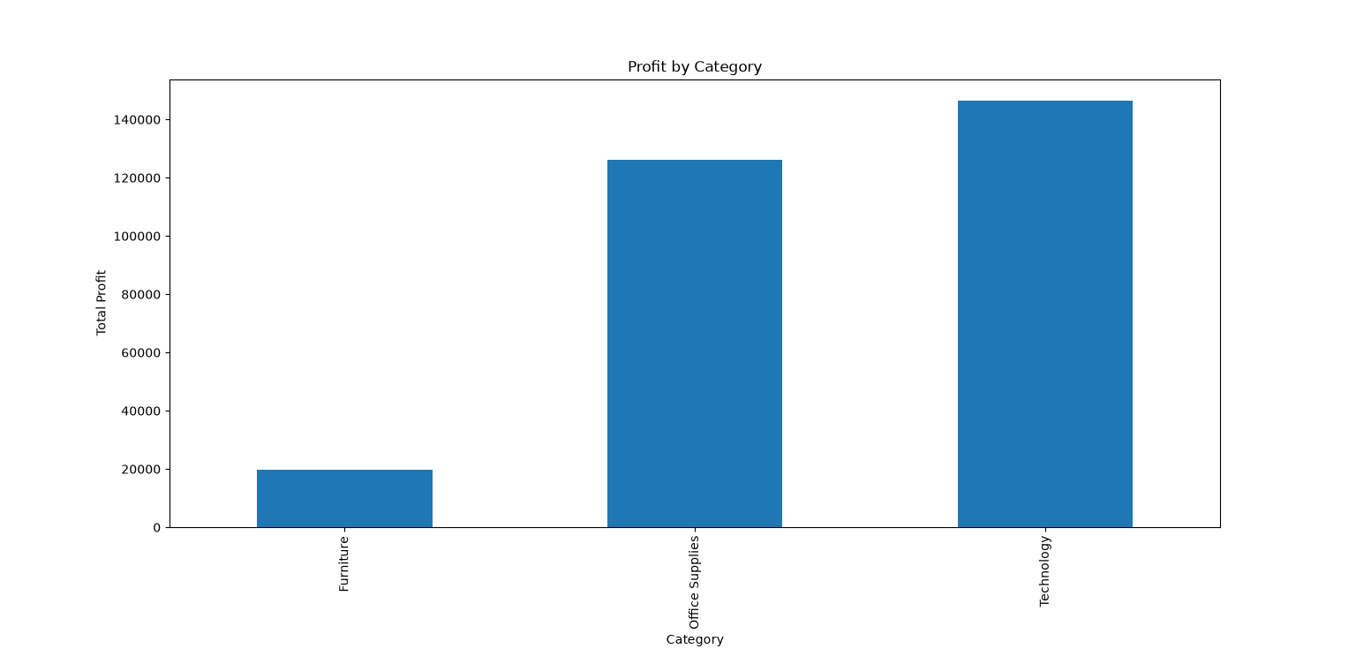

Slide 5
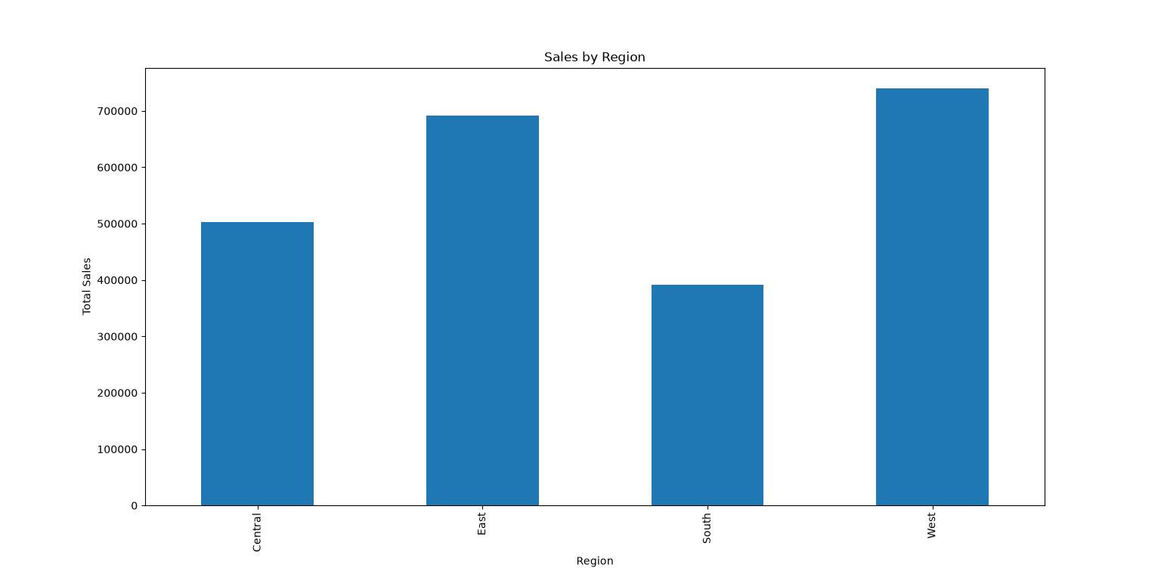

Slide 6
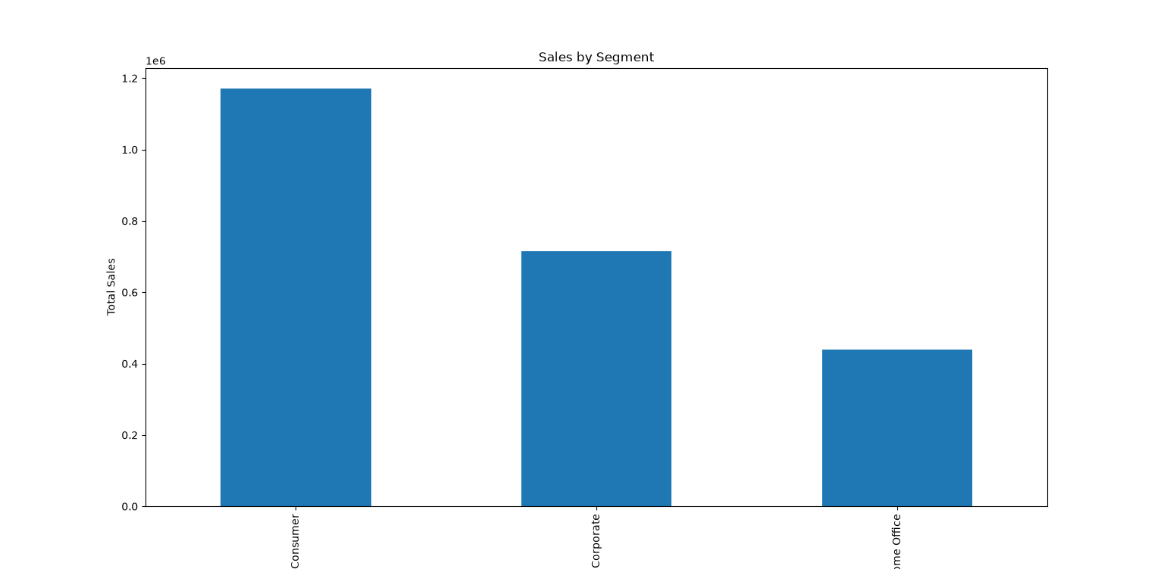

Slide 7
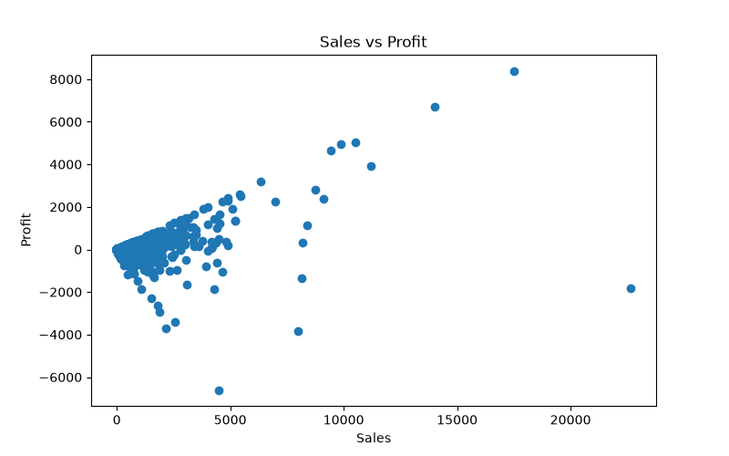

Slide 8
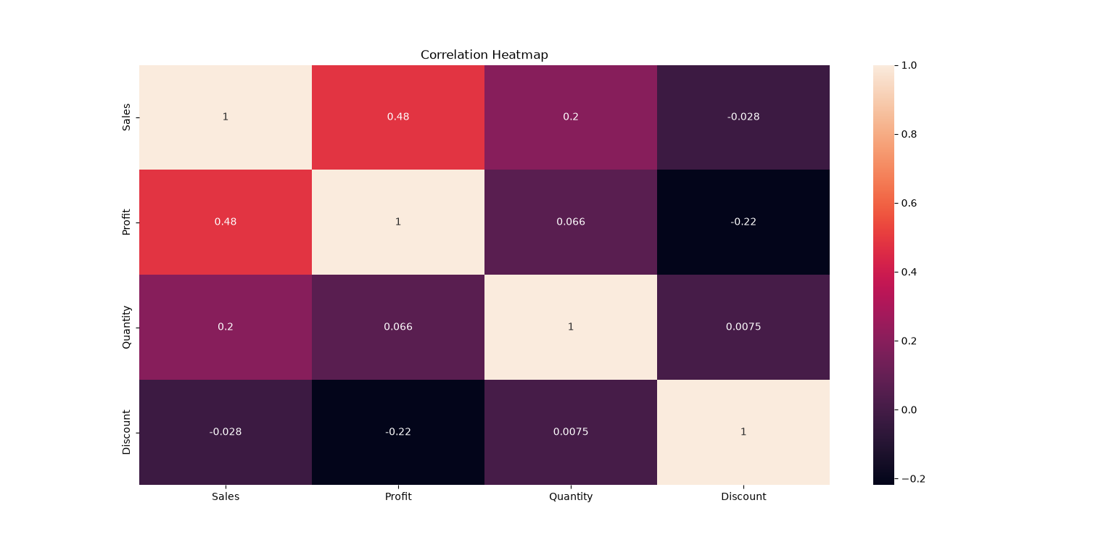

Slide 9
1. Technology generated the highest sales (839,893).
2. Technology generated the highest profit (146,543).
3. West region recorded the highest sales.
4. Discounts negatively impact profit (-0.22 correlation).
5. Sales and Profit have a moderate positive relationship (0.48 correlation).

